Slide 1

Cancer Cases
Najarie Williams, Nia Lacy, Saanjh Khattar, Angela Dakwa, Ashley Onumonu
Columbia GIS
2 August 2019

Slide 2

Agenda
1. Introduction
2. Objective
3. Graph
4. Code
5. Results
6. Interpretation
7. Research

Slide 3
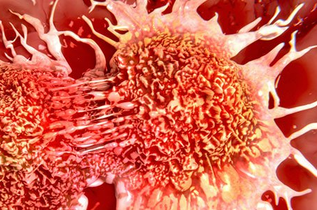
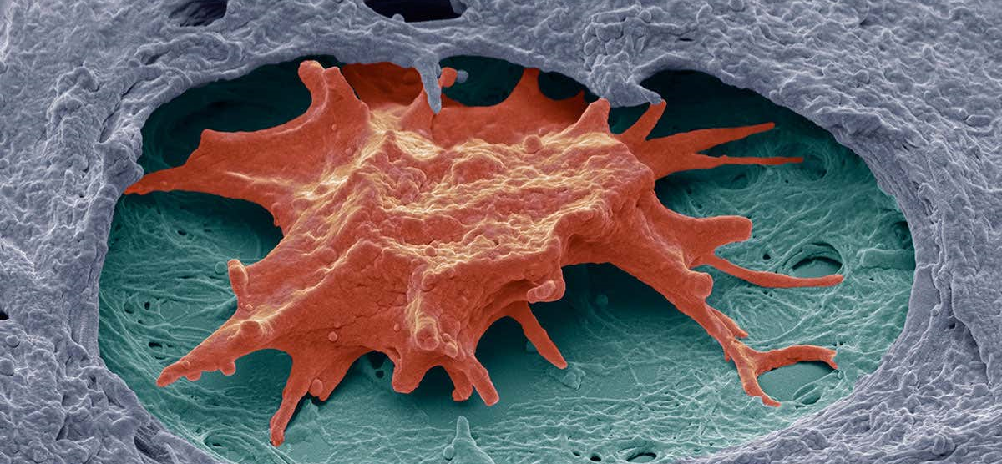
Introduction

Slide 4
What are the top three cancer types found in women?
3.Respiratory
2.Digestive
1.Breast

Slide 5
Breast Cancer Digestive Cancer Respiratory Cancer
Breast Cancer
- Form of cancer that takes place in the cells of the breasts
- Occurs when breast cells grow abnormally
- Mostly affect women
- Male breast cancer is very rare
- Only 1% of all breast cancer is found in men
Digestive Cancer
- Form of cancer that takes place in the digestive system
- Ex: liver and pancreas cancer
- Women's diet and lifestyle affect risk
Respiratory Cancer
- Form of cancer that takes place in the respiratory system
-Number of women that smoke has increased, which has increased the diagnose of respiratory

Slide 6

Objective
Our objective is to inform others about the widespread epidemic of cancer, concerning women..
Cancer is a serious illness that is “caused by an uncontrolled division of abnormal cells throughout the body”.

Slide 7

Results

Slide 8
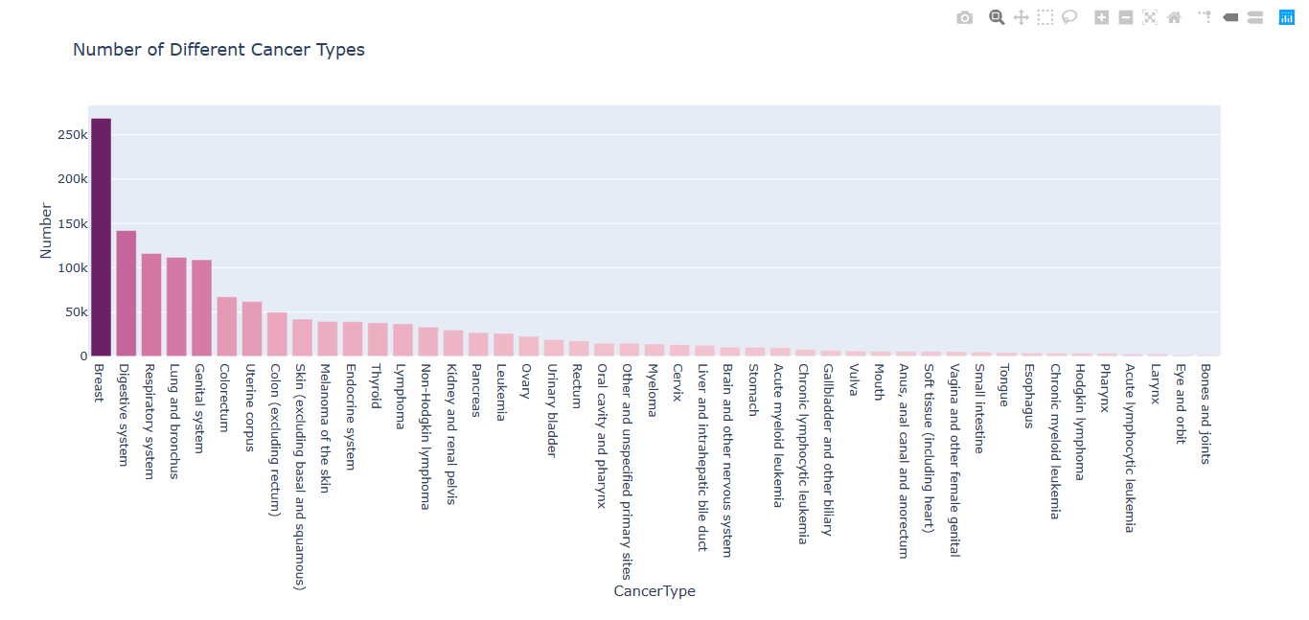
American Cancer Society

Slide 9
Methodology/Approach
We started off by learning the basics of Python, the coding language, and delved deeper into how we can use libraries to create data frames and even how to plot graphs from them. After using the correct commands, which is shown in the next slide, we were able to create a graph for cancer types based on a data file.

Slide 10
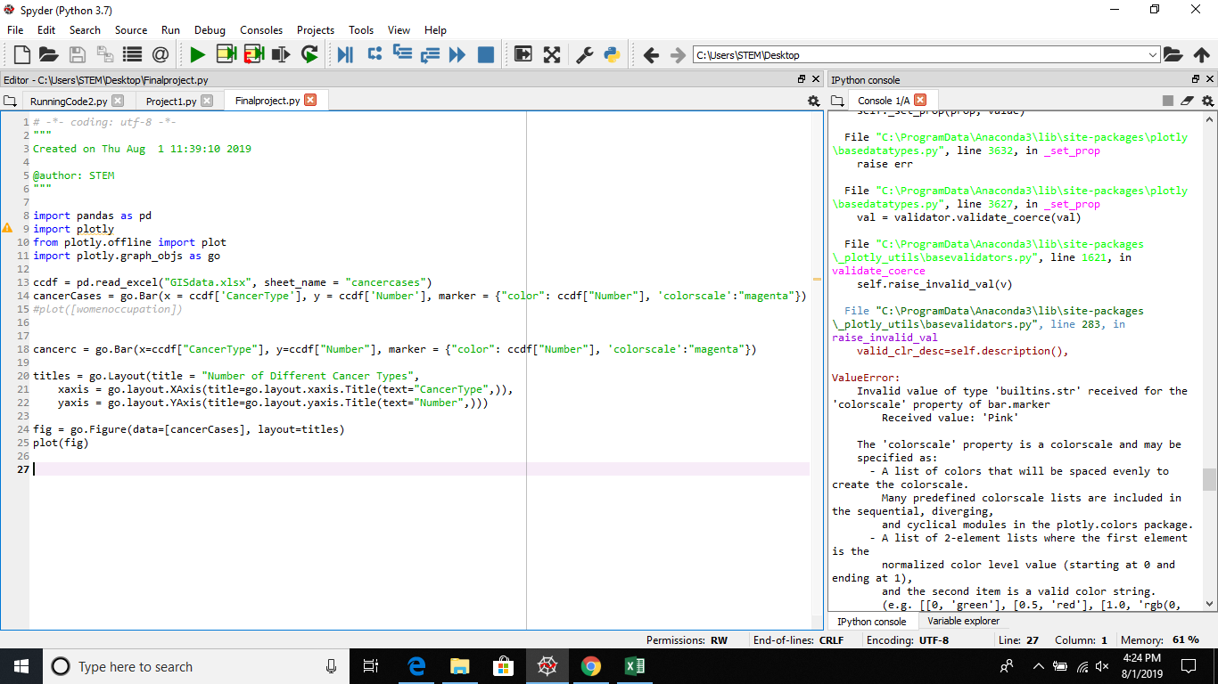

Slide 11
How Did We Interpret Our Graph?
Based on the data in our graph,
We can determine which types of cancers are most volatile to women
Focus on the most volatile cancers and conduct more research on the diseases
Create methods to prevent increasing the number of women with cancer

Slide 12

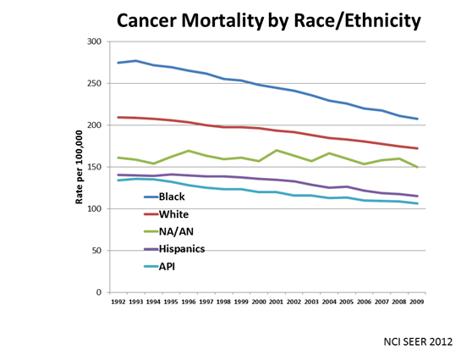
How cancer affects different races
-Black women have a higher mortality rate for Breast cancer..
-According to the National Cancer Institute, non-Hispanic women have the highest rate for breast cancer in the United States.
-Black women have a 71% higher chance to be diagnosed with cervical cancer than white women.
-Black women also have double the higher risk to receive cancer than their White counterparts

Slide 14
How cancer affects ages
Cancer can happen at any age, however its more common in older people.
The median age for breast cancer is 66 years old.
Bone cancer affects mostly people under the age of twenty.
And ten percent of Leukemia diagnoses occur in people under the age 20.
80% of Breast cancers are found in women over the age of 50.

Slide 15


BE AWARE

Slide 16
Works Cited
“Women and Cancer.” Cancer Treatment Centers of America, 19 July 2019,
“Cancer: Definition of Cancer in English by Lexico Dictionaries.” Lexico Dictionaries | English, Lexico Dictionaries, .
“Number of Cancer Deaths per 100,000 Population by Gender.” The Henry J. Kaiser Family Foundation, 11 Feb. 2019,
"Age and Cancer risk." National Cancer Institute,
Pirani, Fiza. “Why Are More Black Women Dying of Breast Cancer Compared to White Women?” Ajc, The Atlanta Journal-Constitution, 6 Dec. 2017
“Breast Cancer.” Mayo Clinic, Mayo Foundation for Medical Education and Research, 22 May 2019,
“Number of Cancer Deaths per 100,000 Population by Gender.” The Henry J. Kaiser Family Foundation, 11 Feb. 2019,
“What Is Gastro-Intestinal (GI) Cancer?: GI Cancer Explained.” GI Cancer, “Lung Cancer.” Mayo Clinic, Mayo Foundation for Medical Education and Research, 16 Nov. 2018, Harvard Health Publishing. “Lung Cancer in Women.” Harvard Health, “Am I at Risk of Breast Cancer?” Breast Cancer Care, 20 Nov. 2018,

Slide 17
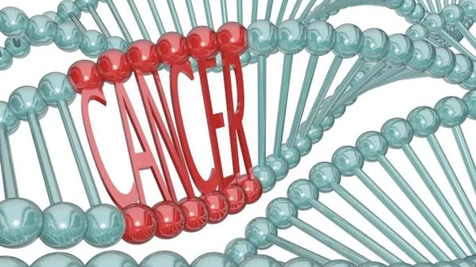
Thank You, Any Questions?

